Slide 1
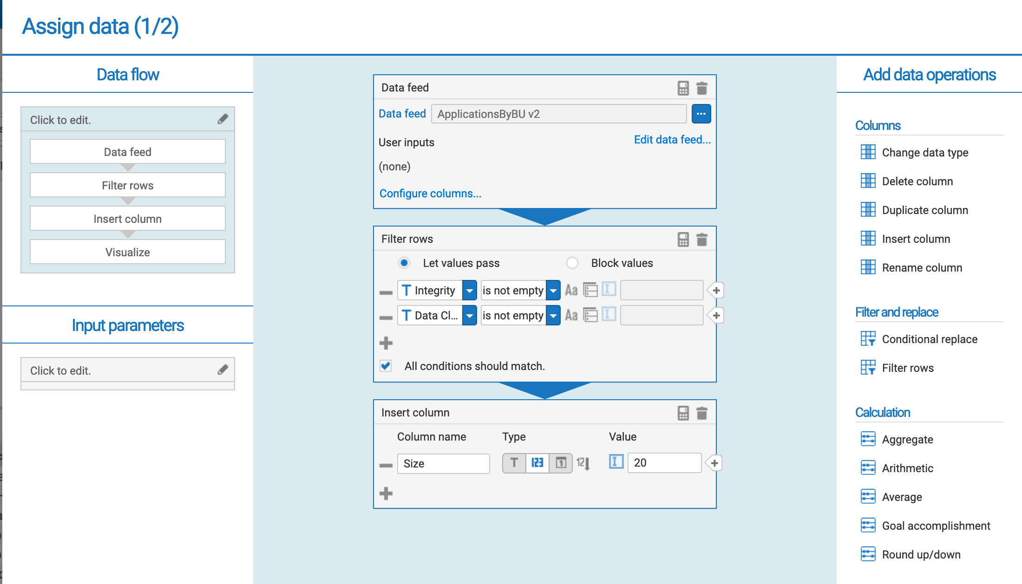

Slide 2
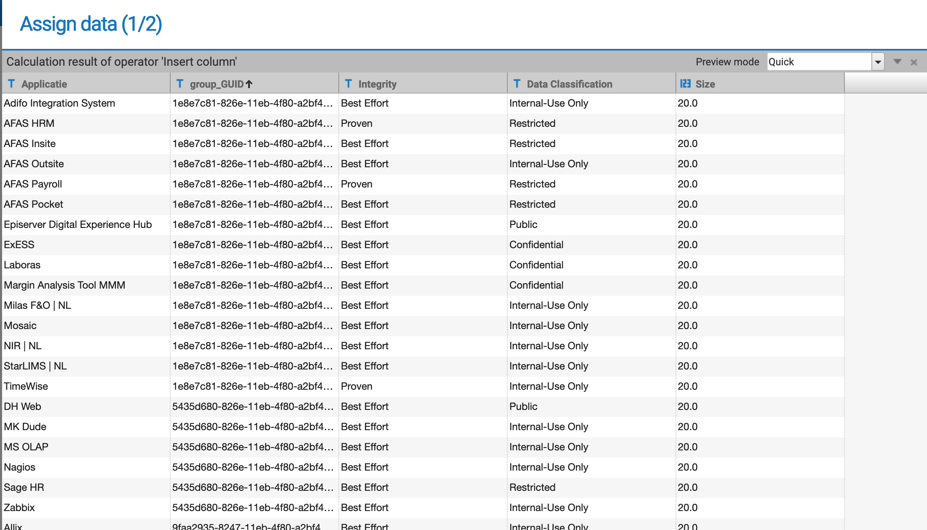
Size is a try-out to test if this affects the text size of the labels. (it doesn’t)

Slide 3
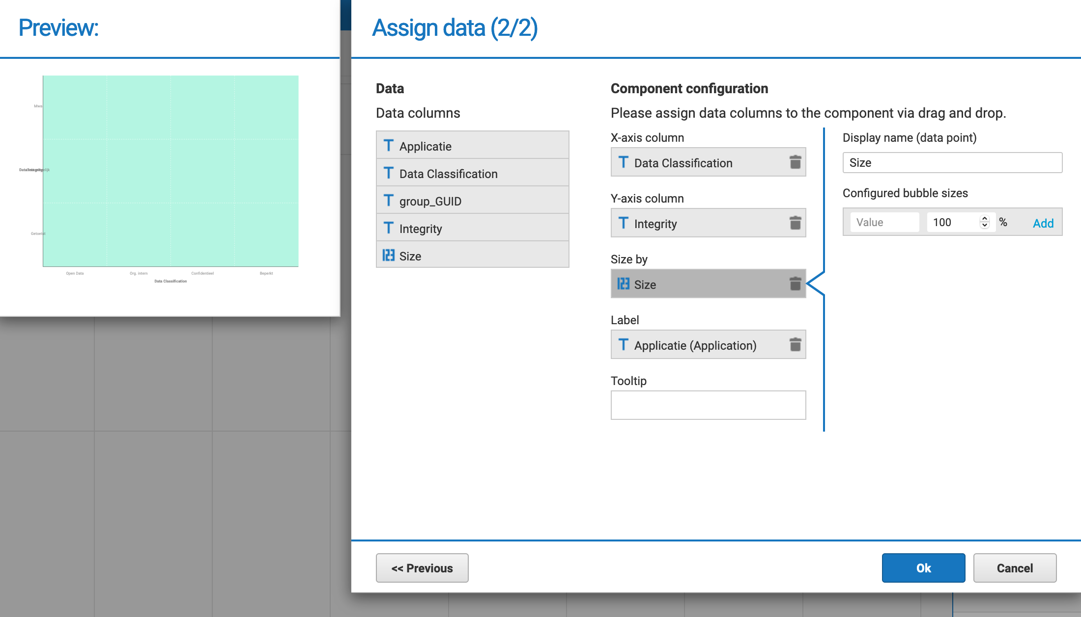
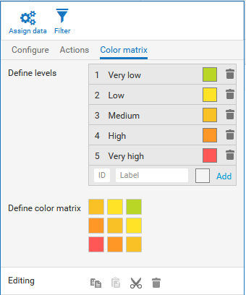
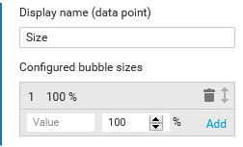
Bubbles sizes can be configured (e.g., small if low value, medium if average value, large if high value). Anyway, you can configure the same size independent of value as you can see in example below.
Levels are to define the matrix amplitude and usually to assign a different color by level, as in the example.
I expect something is shown here in the preview. Used some crappy colour for contast.
The final dashboard shows the same as preview.
Don’t understand what to do with Define levels: Help
Both axis show up in the preview, as configured: Great!
Labels don’t show up: Help
Don’t understand what to do with configured bubble sizes: Help

