Slide 1
Publish Filter and Customization 20150424

Slide 2
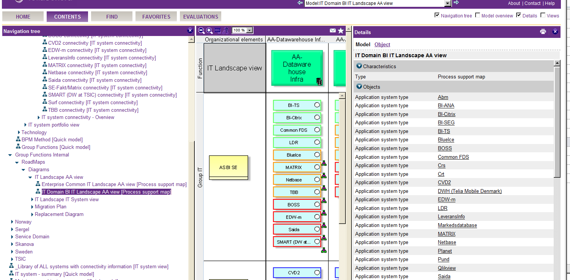
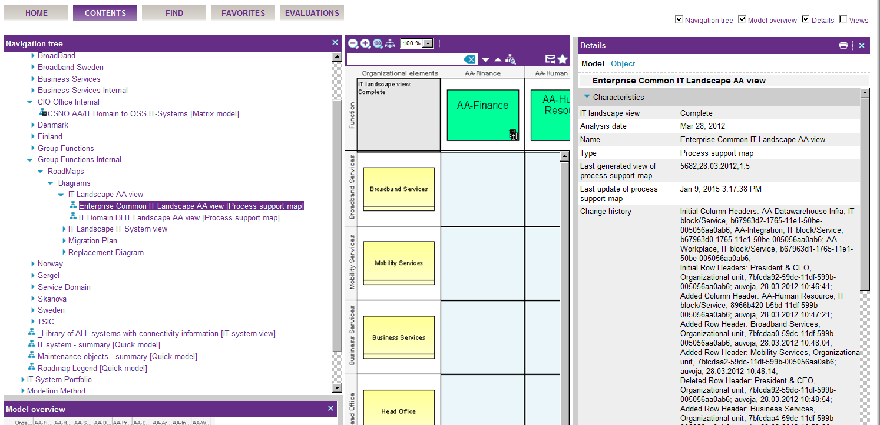
Publisher 7.2
One of the 7.2 ABP customizations was the possibilities to filter out change history
Publisher 9.7
In 9.7 it is not possible to filter out change history, “Last generated view of….” and “Last update of ….”.
Those attribute is maintained by macros, and we can’t update them. In ARIS Design those attributes are valuable, but for management those attribute is disturbing . So they should not be visible in ABP

Slide 3
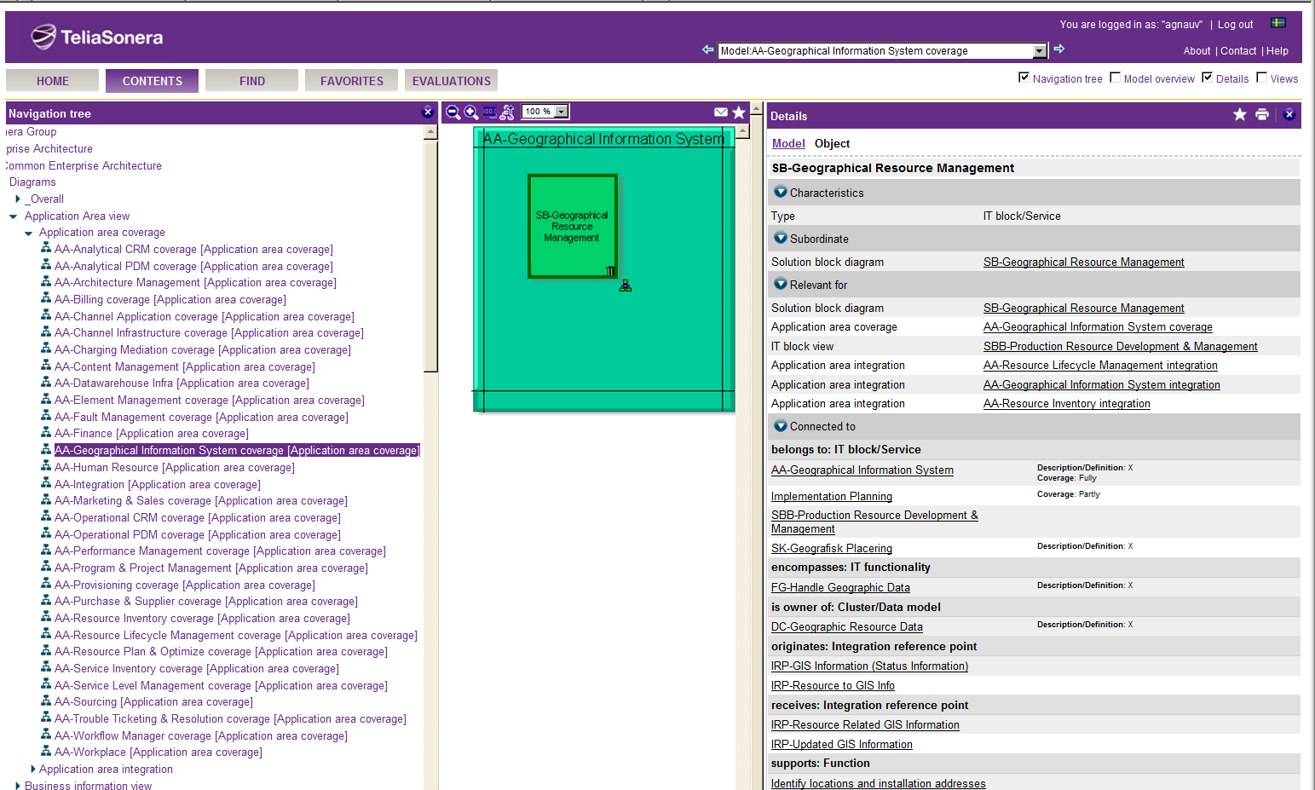
Customization still missing in Publisher Subtitles and attribute on connection
Publisher 7.2

Slide 4
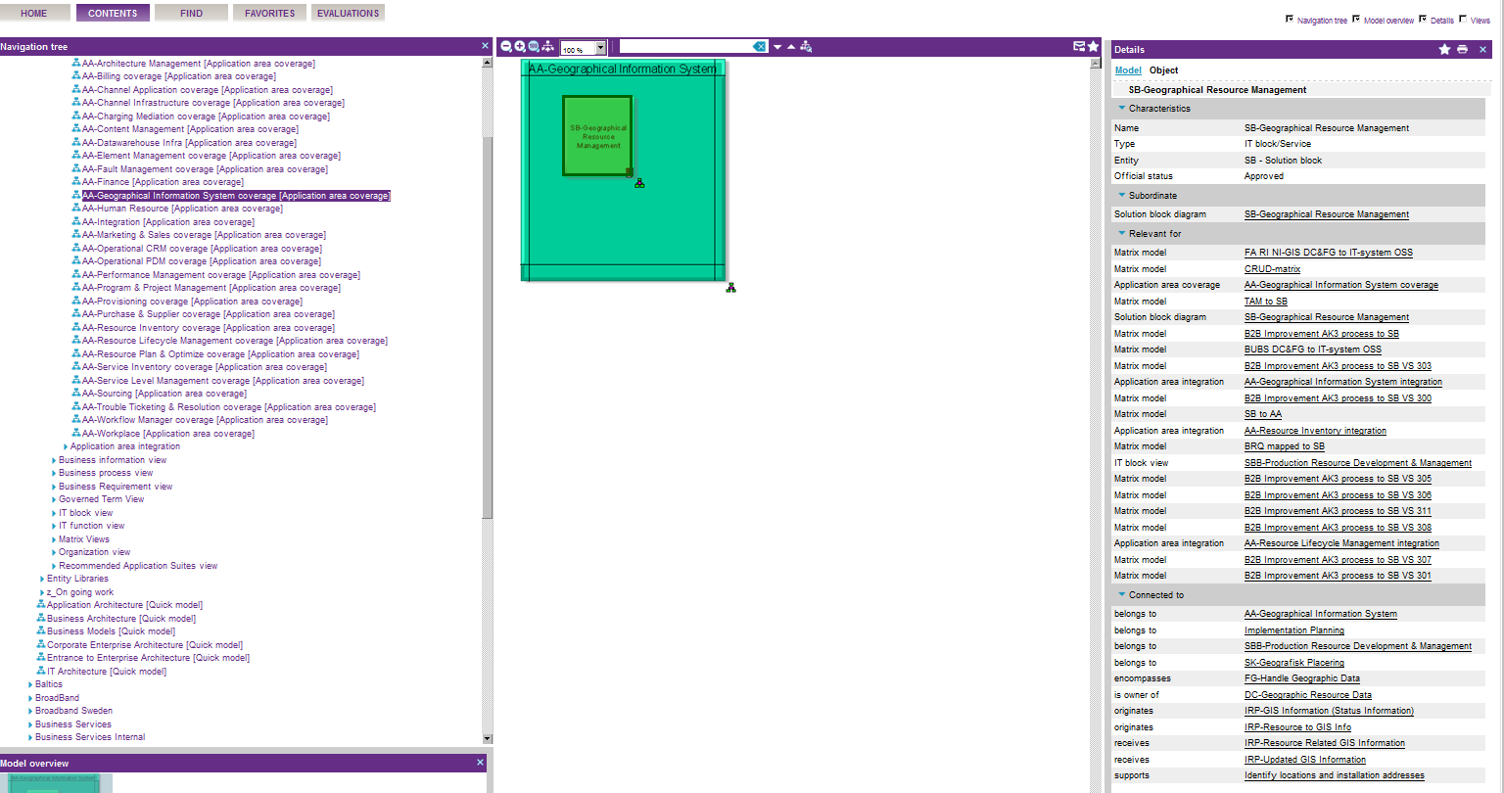
Customization still missing in Publisher Subtitles and attribute on connection
Publisher 9.7

