Slide 1
ARIS Simulation
Martin Scheid – ARIS Product Management

Slide 2
ARIS Simulation (2026)
Forecast. Validate. Improve. With the new ARIS Simulation
Simulation of BPMN models directly in the web
without requiring a Java client or external tools
Use real data from ARIS Process Mining to enrich
simulation scenarios, enabling data-driven
validation
ARIS
Simulation
Compare different process scenarios to
assess impacts and choose optimal
paths for process optimisation
Save simulation outcomes as new or
enhanced process models for the future
use or further analysis
Benchmark simulated results against KPIs derived
from mining insights to validate improvements
A user-friendly, streamlined simulation setup with
steps like model check, enrichment, monitoring,
analysis, and comparison, lowering entry barriers
for non-experts

Slide 3

Benefits of the ARIS Simulation
Forecast. Validate. Improve. With the new ARIS Simulation
Top-tier user experience featuring integrated Project Management for the Simulation Project. Allowing fast redesign and innovation cycles
Enhanced time to value: Quicker and more comprehensive insights through integration with ARIS Process Mining
Leverage the ARIS model repository to reuse, enhance, and confidently drive process improvement projects - without the guesswork

Slide 4
Use Case:
Processing of incoming invoices

Slide 5
Use Case: Evidence-Based Automation Choice
Overview
ARIS Simulation gives customers a decision-grade way to choose the right redesign path before they invest. Instead of debating opinions about manual improvement vs. RPA vs. agentic AI, teams can run comparable scenarios on the same process model and quantify outcomes under real-world constraints like demand peaks, resource capacity, exception rates, and compliance controls.
In practice, customers model the as-is process, define three realistic to-be variants, and enrich them with operational and cost assumptions. ARIS Simulation then predicts cycle time, cost per case, backlog risk, and sensitivity to volume spikes. The result is a clear, defensible recommendation for where manual simplification is sufficient, where RPA delivers fast ROI, and where agentic AI adds differentiated value for exception-heavy or non-deterministic work—while making governance requirements explicit.
This positions ARIS Simulation as the neutral “evidence layer” across automation choices: it reduces investment risk, accelerates stakeholder alignment, and turns redesign decisions into measurable, board-ready business cases.

Slide 6
Use Case: Evidence-Based Automation Choice
Use Case Baseline
A regulated, high-volume organization (e.g., banking, insurance, manufacturing shared services) faces pressure to reduce cycle time, cost, and compliance risk in critical back-office operations.
Therefore, the CFO and COO launch a cost and service improvement program.
A top candidate process is flagged as “automation-ready” based on volume, delays, and error rates derived from Process Mining.
The organisation is caught between multiple “good-sounding” options:
Robotic Process Automation
Agentic AI
Which option produces the best outcome?
Notes:
Manual processing improvements
Lean redesign, role clarification, better work instructions, and system configuration tweaks.
RPA
Quick automation of repetitive user-interface actions, but with maintenance overhead and limited adaptability.
Agentic AI
More flexible “digital workforce” for non-deterministic tasks (e.g., semi-structured document interpretation, exception handling), but with governance, auditability, and risk considerations.
The CEO team sees competing claims:
Operations prefers incremental manual improvement first.
Digital IT advocates RPA for speed-to-value.
Innovation leadership argues for agentic AI to future-proof capability.
Why existing approaches fail
Spreadsheet cases ignore process variability and resource contention.
Vendor ROI calculators assume ideal conditions.
Pilot-first approaches are slow and expensive, and they risk selecting a suboptimal design that becomes difficult to unwind.
Agentic AI proposals raise governance questions that require measurable simulation evidence rather than narrative promises.
Which option produces the best outcome? given real demand variability, exception rates, compliance constraints, and workforce capacity?

Slide 7
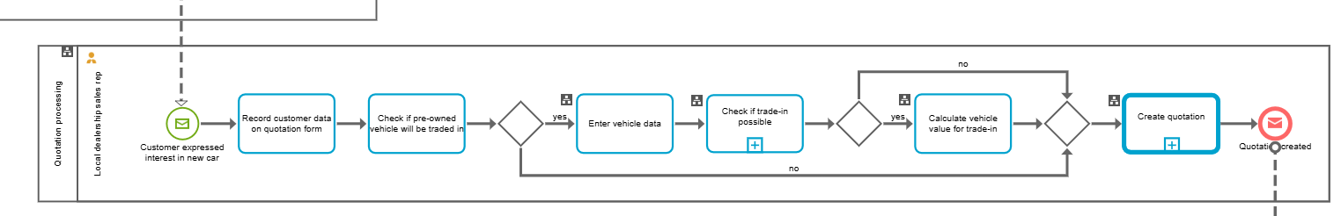
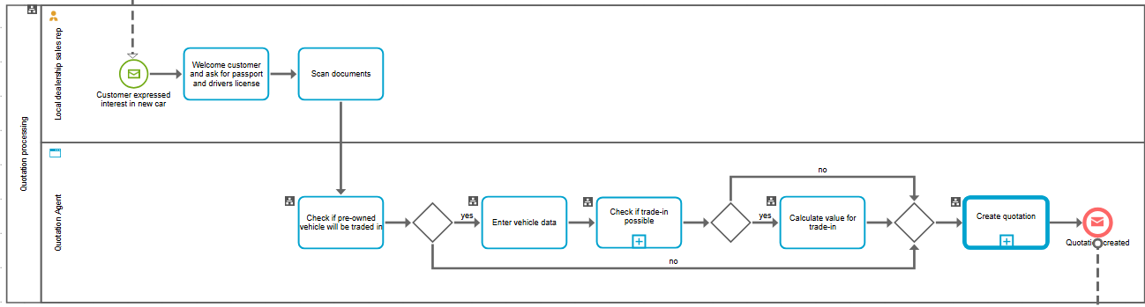
Use Case: Evidence-Based Automation Choice
On the example

Slide 8







Use Case: Evidence-Based Automation Choice
The Way Forward
Use ARIS Simulation as a central, trusted decision layer to:
Predict performance and cost outcomes under realistic conditions.
Compare redesign scenarios using a consistent model and data.
Provide evidence that supports a formal investment decision and a phased adoption roadmap.
6
1
5
2
4
3
1
2
3
4
5
6
Design your process
Enrich your process with Simulation relevant details
Specify your simulation project and scenarios
Perform the Simulation
Analyze the Simulation outcome
Derive findings, validate assumptions and generate learnings
Notes:
ARIS Simulation combines:
Process model structure (as-is and potential to-be variants),
Operational parameters (arrival rates, resource calendars, skill constraints),
Cost and risk assumptions, and
Automation-specific performance profiles (RPA throughput, AI success rate, human fallback rules)
to run scenario simulations and report predictions in business terms.

Slide 9


